Slide 1
The third-round blitz “Boomerang”
Ответы на задания.
Rainbow
School №59
Cheboksary

Slide 2
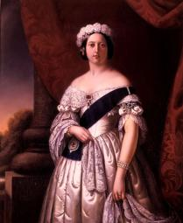
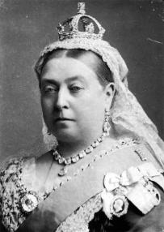
1. Whose nickname was “the grandmother of Europe”? What is her full name?
Queen Victoria (Alexandrina Victoria; 24 May 1819 – 22 January 1901)
Queen Victoria was known as the grandmother of Europe. She and her husband, Albert, Prince Consort, had nine children, who presented her with forty grandchildren.
She married many of her children into other royal families around the continent. Eight of them ruled Britain, Greece, Norway, Prussia, Romania, Russia, Spain and Sweden.
Among her grandchildren were the future German Emperor Wilhelm II; the future Queen Sophie of Greece; Maud the future queen consort of Norway; the future czarina of Russia, Alexandra; Marie, the future consort of King Ferdinand I of Romania; and the future Queen Victoria Eugenie of Spain.
So every ruling house in Europe is somehow connected to the UK as a result.

Slide 3
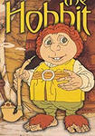

2. An Oxford professor writes a fairy tale for his children. What famous book is that?
The Hobbit and The Lord of the Rings by Professor John Ronald Reuel Tolkien
The Lord of the Rings is an epic high fantasy novel written by English philologist and University of Oxford professor J. R. R. Tolkien. The story began as a sequel to Tolkien's 1937 children's fantasy novel The Hobbit, but eventually developed into a much larger work. It was written in stages between 1937 and 1949, much of it during World War II. It was published in three volumes "The Fellowship of the Ring", "The Two Towers" and "The Return of the King" in 1954 and 1955.
It is the third best-selling novel ever written, with over 150 million copies sold.
Книга «Хоббит, или Туда и обратно» была написана Джоном Руэлом Толкиеном не для продажи и не для печати. Оксфордский профессор имел своей целью написать небольшую сказку, историю для чтения собственным сыновьям. Но он так увлёкся своим произведением, что нарисовал ещё карты и иллюстрации, дополняющие произведение. Первое время существовал лишь один рукописный экземпляр книги, которую профессор изредка давал почитать своим друзьям и ученикам.
Именно благодаря одной из его учениц книга и увидела свет, а позже и получила продолжение в виде трилогии «Властелин колец» и «Сильмариллиона». Интересно то, что рецензентом для этой книги послужил 10летний мальчик, сын директора издательства, в котором она впервые была напечатана.

Slide 4
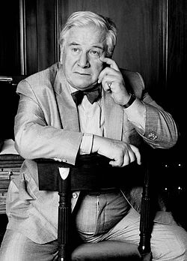
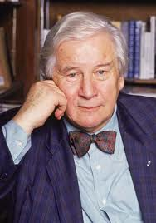
3. This famous British actor, writer and dramatist, filmmaker and public figure had a Russian surname. He is Sir…?
… Peter Alexander Ustinov
(16 April 1921 – 28 March 2004)
An English actor, writer and dramatist. He was also renowned as a filmmaker, theatre and opera director, stage designer, author, screenwriter, comedian, humourist, newspaper and magazine columnist, radio broadcaster and television presenter. A noted wit and raconteur, he was a fixture on television talk shows and lecture circuits for much of his career. He was also a respected intellectual and diplomat who, in addition to his various academic posts, served as a Goodwill Ambassador for UNICEF and President of the World Federalist Movement.
Ustinov was the winner of numerous awards over his life, including two Academy Awards for Best Supporting Actor, Emmy Awards, Golden Globes and BAFTA Awards for acting, a Grammy Award for best recording for children, as well the recipient of governmental honours from, amongst others, the United Kingdom, France and Germany.

Slide 5
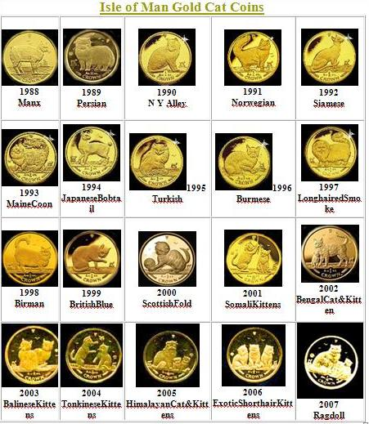

4. Special coins were minted on the Isle of Man with this animal on the reverse. What animal is it? What types of such coins have been released?
The Isle of Man (IOM) - a British Island located between Ireland and the United Kingdom - has been producing gold coins with CAT designs since 1988. Each year has a different CAT design (the Manx, Persian, Norwegian Forest and so on) on one side and the official portrait of Her Majesty Queen Elizabeth II on the other.
The Cat Gold Coins are struck
in pure .9999 fine gold in 1/25,
1/10, 1/5, 1/2, and 1 ounce sizes. They are minted in limited quantities. In some years one ounce silver coins were also produced.
.
These gold coins have continued to attract collectors, bullion buyers and cat lovers with their beauty and quality since their inception.

Slide 6
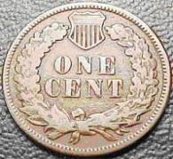
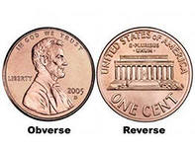
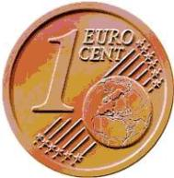
5. Coins of what denomination are the most common in the world?
Answer: one-cent coins / монеты достоинством в 1/100 денежной единицы
As it says on the U.S. Mint website, “… the penny is the most widely used denomination currently in circulation.”
Согласно Министерству Финансов США, в 1998 году было выпущено более 10 миллиардов монет достоинством в 1 цент. Точное количество выпущенных монет следующее: 1 цент - 10.257.400.000 штук, 5 центов - 1.323.672.000, 10 центов - 2.335.300.000, 25 центов - 1.867.400.000, 50 центов - 30.710.000.
Цент — это производная денежная единица и разменная монета достоинством в одну сотую базисной денежной единицы в ряде стран. В Соединённых Штатах и Канаде одноцентовую монету обычно называют пенни (по образцу английского пенни).
Наряду с центами во многих государствах обращаются монеты, название которых тоже происходит от латинского centum (и которые тоже являются сотыми частями основной денежной единицы). Это и аргентинские и колумбийские сентаво, и венесуэльские и коста-риканские сентимо, и панамские и уругвайские сентисимо, и сенити королевства Тонга, а также болгарская стотинка. После введения в оборот наличного евро самой распространенной монетой Старого Света стали евроценты. Таким образом, разменные "сотенные" монеты находятся в обращении около трети государств и являются самыми распространенными монетами мира

Slide 7
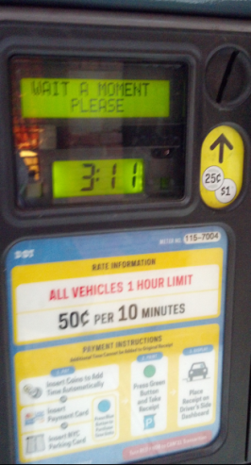
6. They often say “One moment!” in Great Britain when they ask to wait. But how long is this time measure?
In Old English, a moment was an exact measurement of time being 1.5 seconds or 1/40th of one minute. However, in more modern English usage it has simply meant an inexact and brief length of time.
A moment can be anywhere from a few seconds, up to a minute. Generally, a moment is defined as a point in time lasting from 1-3
seconds.

Slide 8



7. This means of communication was invented in the United Kingdom exactly twenty years ago. What is the name of this service and what was the text of the first message transmitted?
SMS (Short Message Service)
The first message was ‘Merry Christmas’
Neil Papworth is the engineer who sent the world’s very first SMS/text to a mobile phone. On December 3, 1992, Neil sent a text to Vodafone executive Richard Jarvis, saying ‘Merry Christmas’. Little did they know they were setting the foundation for a 20-year long habit enthralling billions of teenagers (and unnerving their parents).

Slide 9


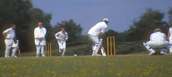





8. Name the sports that come from England.
Many of the world's famous sports began in Britain, including cricket, football, lawn tennis, bowling, golf, rugby, badminton, darts and others.
Cricket (born in the XIIIth century) is the English national sport in summer. There are two teams. Each team has eleven players. They must wear white boots, a white shirt and white long trousers.
Football. Modern football was born in 1863 when the English Football Association was founded and the first basic rules were established.
Rugby originated from Rugby school in Warwickshire (1823). It is similar to football, but played with an oval ball. Players can carry the ball and tackle each other.
Golf was born in Scotland in the XIVth century. Now there are over 400 golf courses in Scotland alone.
Table tennis was invented in England in 1880. It began with Cambridge University students using cigar boxes and champagne corks.
Badminton takes its name from the Duke of Beaufort’s country home, Badminton House, where the sport was first played in the 19th century.
The game of darts, as it is today, was invented in the north of England in a town called Grimsby.
The first bowling center opened in London in 1455.
University Boat Race. In the nineteenth century, students at Oxford and Cambridge, Britain's two oldest universities, were huge fans of rowing. In 1829, the two schools agreed to hold a race against each other for the first time on the Thames River and a tradition was born.

Slide 10
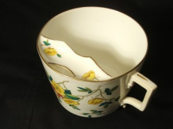
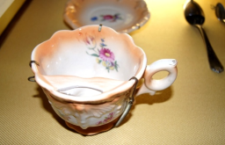
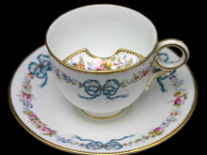
9. What was special about cups for men with moustache ?
Moustache cups
The moustache cup is a drinking cup with a semicircular ledge inside that runs along the perimeter of the cup along one edge. The ledge has a half moon-shaped opening to allow the passage of liquids and serves as a guard to keep moustaches dry. When the user brings the mustache cup to his mouth, his mustache rests on the ledge, rather than in the liquid.
It is generally acknowledged to have been invented in the 1860s by British potter Harvey Adams (born 1835). It was the Victorian Era and most men sported a moustache at the time. Many of these moustaches were waxed or dyed. Drinking a hot cup of coffee or tea resulted in melted wax or wet dye to ooze into the drink or down the embarrassed drinker's face. To solve this problem, Adams invented a ledge (also known as a mustache guard) that allowed the gentleman to drink his beverage while protecting the well groomed moustache from the liquid.

Slide 11
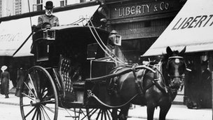
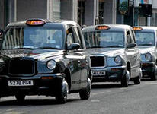
10. What must all London taxicabs have in their boots?
London Taxis must carry a bale of hay and a sack of oats.
In the 1800's cabbies drove horse-drawn carriages. The 1831 London Hackney Carriage Act made it an offence for drivers to feed their horse unless it was from a bag of corn or with hay from their hands.
Disputes have often arisen, and some firms did manufacture tiny bales of hay, so that taxi drivers could remain within the law when they first became mechanised. (The act was finally repealed in 1976).

